Slide 1

Field containing a tree and daisies
Total area = 9 m²
Quadrat
Area = 1m²
Bush
Notes:
This can be used as an alternative for either random or systematic sampling (instead of effect of proximity to road).

Slide 2
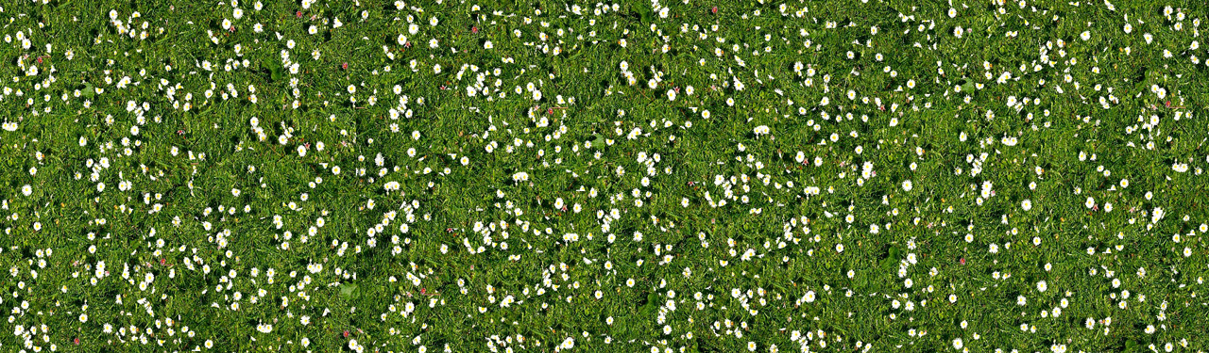
Notes:
This image can be used instead of the illustrated one on slide 1 as a stretch or for a higher attaining group. You will have to decide whether you are using this a model and deciding on the area, or letting students measure the area of this print out and the quadrat accurately (this is harder to calculate!).

Slide 3
Notes:
Spare quadrats to print

